Slide 1

ACADEMIC PERFORMANCE ANALYSIS REPORT: University of the Pacific

Slide 2

Group 6
Aman Singh
Nithish Cheruku
Gouthami Nadupuri
Lily Veronica Koppoli
Sreekanthreddy Maddur
Lasya Lavanya Tirumalasetty
Guided by: Prof. Arshad Khan Date: April 25, 2025

Slide 3
Agenda
Introduction & Objective
Tech Stack & Tools
Data Collection & Preprocessing
Analysis & Key Insights
Visualizations & Dashboards
Recommendations & Conclusion

Slide 4
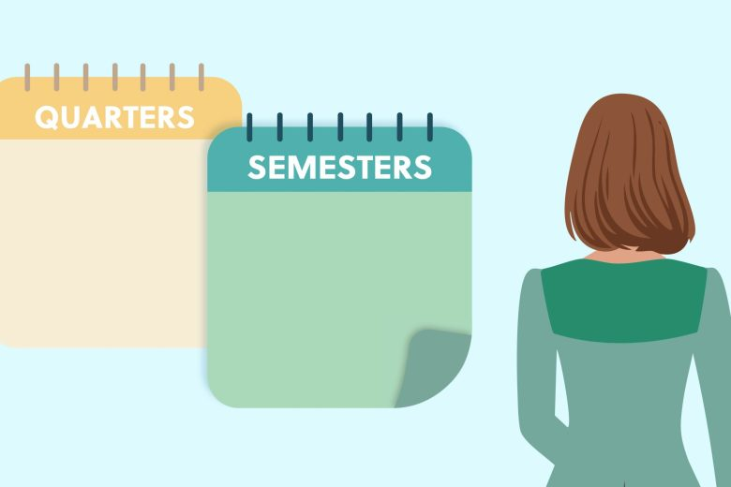
Introduction & Objective
This project analyzes academic performance using institutional student data across semesters. The goal is to uncover GPA patterns, department-level effectiveness, and instructor influence, and deliver data-driven recommendations. The results will help improve academic outcomes and inform policy.

Slide 5
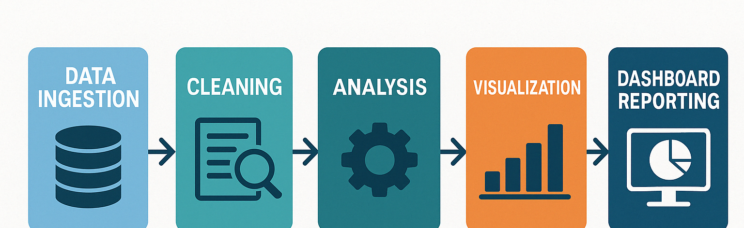
Data Processing Flowchart

Slide 6
Tech Stack & Tools
Frontend & Analysis Tools:
Google Colab for development and collaboration
Matplotlib for visualizations
IPyWidgets for interactivity
Backend & Processing:
Python, Pandas, NumPy for data wrangling and analysis
CSV files as data source
Local and cloud-based storage via Google Drive

Slide 7
Data Collection & Preprocessing
Academic records from 2012 to 2020, covering multiple terms. Fields include GPA, credit hours, course
codes, and instructor info.
Cleaning Process:
Merged files across semesters
Verified no missing/duplicate values
Standardized term labels and column names
Sorted data chronologically for trend analysis

Slide 8
Student Performance Insights
Average GPA: 2.83, Median: 3.08
Summer I 2019 had highest GPA (4.0); Summer II 2018 lowest (2.6)
Top-performing majors: Business Admin - Bus Law Con, Pre-Dentistry
Lowest-performing: Business Admin - Intl Bus Con
Instructor GPAs ranged from 3.7+ to below 1.5

Slide 9
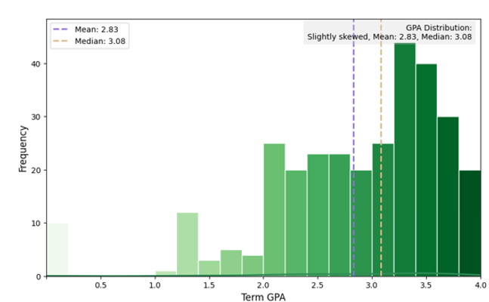
GPA Distribution Overview: The average GPA of students is 2.83, while the median GPA is slightly higher at 3.08. This indicates a slight right-skewed distribution, suggesting more students score above the average. Such a trend highlights a positive academic performance trend among the majority. However, the presence of students below average calls for targeted academic support. Customized intervention programs can help bridge this performance gap effectively.

Slide 10
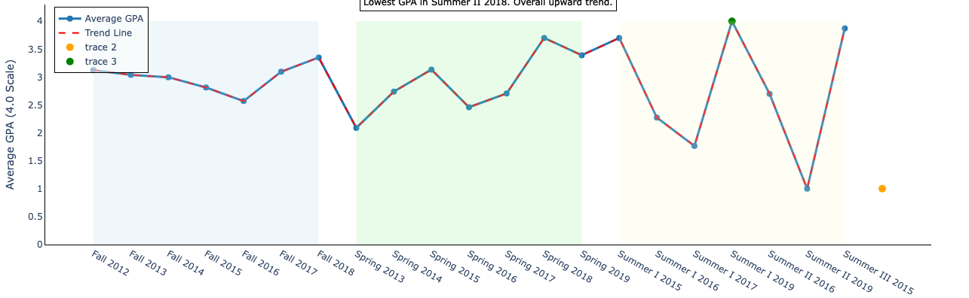
Term-Wise GPA Trend: The highest average GPA (4.0) was recorded in Summer I 2019, while the lowest (2.6) occurred in Summer II 2018. Despite some short-term dips, the overall GPA trend shows consistent academic improvement over time. These fluctuations suggest varying academic challenges or instructional effectiveness across terms. Adopting successful strategies from high-performing terms can help uplift lower-performing ones. A term-wise evaluation ensures targeted interventions for improved academic consistency.

Slide 11
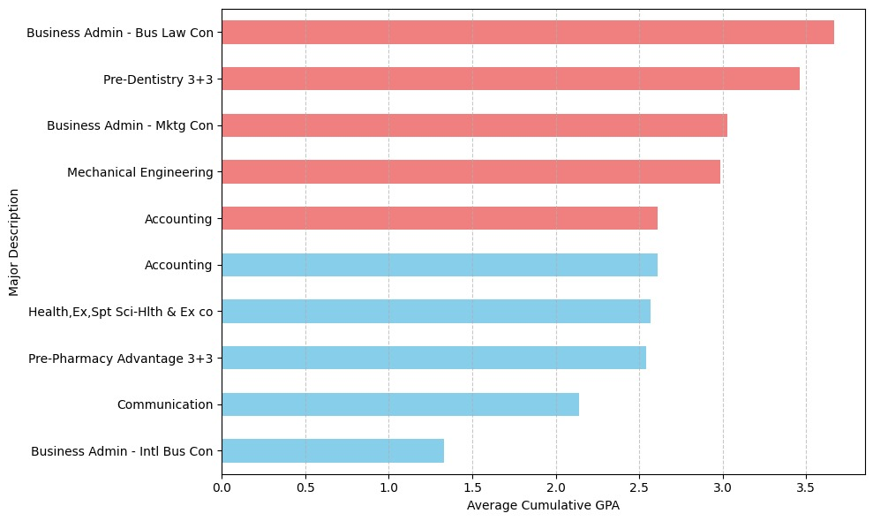
GPA by Major Performance: Students in Business Admin - Bus Law Con and Pre-Dentistry 3+3 majors achieved the highest average GPAs. Business Admin - Intl Bus Con majors recorded the lowest GPA performance among all disciplines. This variation reflects differing academic demands and student preparedness across programs. Highlighting these disparities helps target specific majors for academic support interventions. Strengthening mentoring and tutoring for underperforming majors can help bridge the achievement gap.

Slide 12
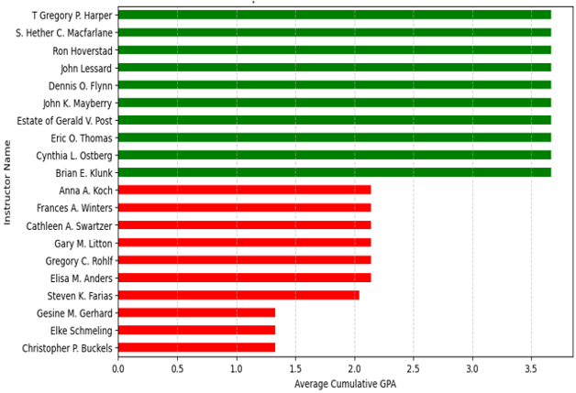
Instructor Impact on GPA: Top-performing instructors like T. Gregory P. Harper consistently support high student GPAs near 3.7. In contrast, instructors at the bottom show average GPAs below 1.5, indicating major performance gaps. These discrepancies may stem from varied teaching approaches, grading rigor, and student engagement. A peer mentoring system can help underperforming instructors adopt effective strategies. Standardizing instructional quality will promote fairness and improve overall academic success.

Slide 13
Student Progression & Retention Highlights:
GPA peaked at 3 and 16 credit hours, showing unique performance curves
Fall 2015 and Spring 2016 had highest enrollments; minimal dropouts observed
ACTY course had more failures than passes
Graduation rate dropped in 2016 (64%) but recovered by 2019 (100%)

Slide 14
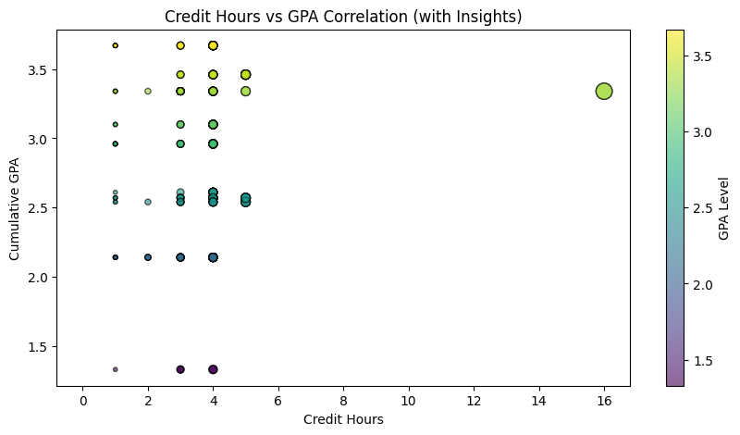
Credit Hour vs GPA Correlation :
Students with either very low (3) or very high (16) credit hours tended to have higher GPAs, while those in the mid-range (3–5) showed greater variability in performance. This suggests that optimal credit load depends on the student's ability to manage course intensity effectively.

Slide 15
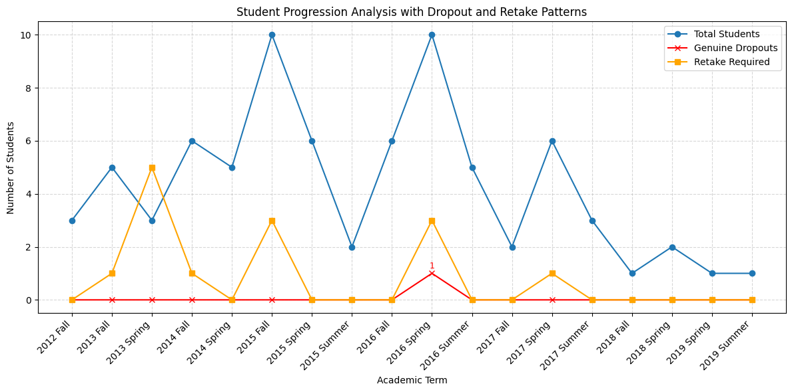
Student Progression Analysis :
Student enrollment was highest during Fall 2015 and Spring 2016, with a noticeable increase in course retake requirements during the same period. Despite these academic challenges, the dropout rate remained consistently low across all terms. This pattern suggests that while students are committed to continuing their education, they may struggle with specific subjects. The spikes in retake requirements point to potential gaps in curriculum effectiveness or academic support. Targeted interventions during high-retake terms can help improve progression and reduce academic bottlenecks.

Slide 16
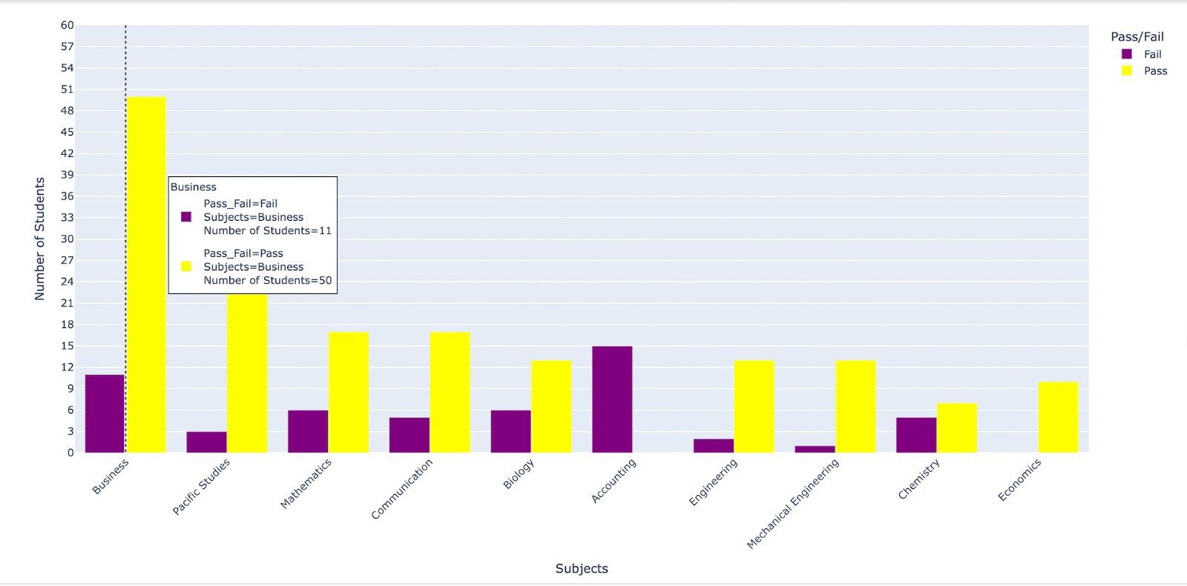
Pass/Fail Analysis for Key Subjects : The Business program had the highest student participation, with a notable number of failures. Accounting (ACTY) stood out with more students failing than passing, indicating a critical academic gap. Other subjects like Math and Biology also displayed moderate failure rates. Such patterns suggest potential difficulties in subject comprehension or instructional delivery. Focused academic support in high-risk subjects like ACTY can improve student outcomes and retention.

Slide 17
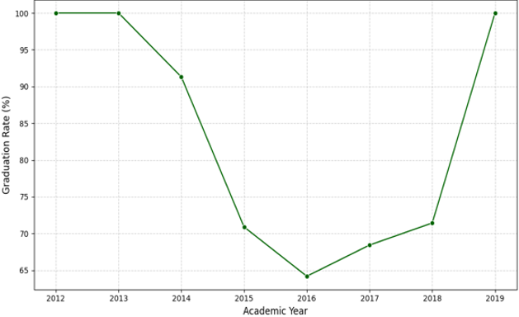
Graduation Rate Analysis : Graduation rates stayed consistently at 100% from 2012 to 2013. A steep decline began in 2014, bottoming out at 64% by 2016. This drop may reflect academic restructuring or limited student support during that time. From 2017 onward, a steady recovery was observed, reaching 100% by 2019. Institutions should monitor such patterns closely to ensure stable student success.

Slide 18
Department & Course Insights Findings:
THEA and HONR had the highest average GPAs
1
WRIT and EMGT reported the lowest
2
Elective popularity: 'What is an Ethical Life?' ranked highest
3
Dashboards revealed term GPA patterns, instructor impact, and course performance
4

Slide 19
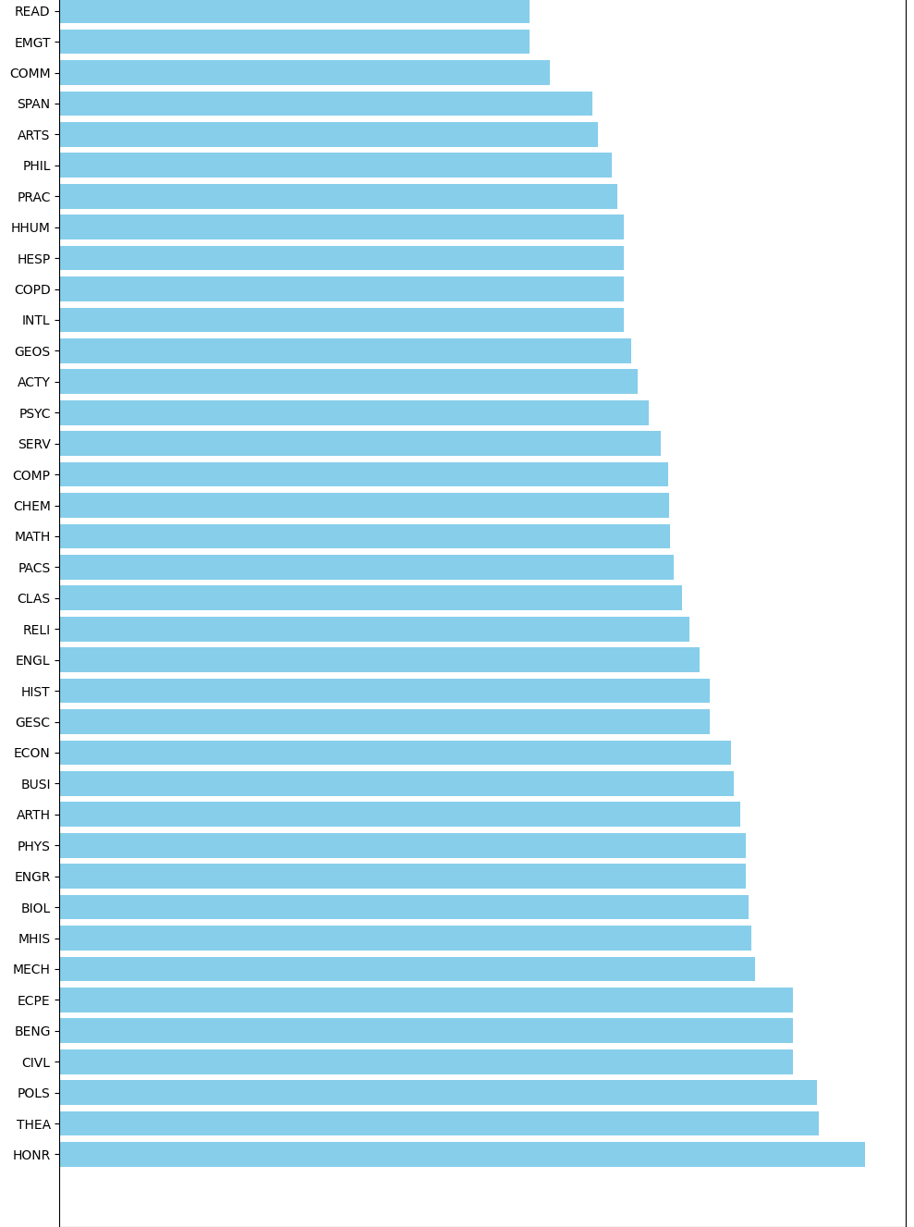
Average GPA by Subject Code: Subjects like HONR, THEA, and POLS recorded the highest average cumulative GPAs, above 3.5, indicating strong student performance. On the lower end, WRIT, READ, and EMGT had the lowest GPA averages, suggesting challenges in these areas. The wide GPA range across subjects reflects varied difficulty levels, teaching effectiveness, and student preparedness. Intervention efforts should focus on low-performing subjects to balance academic achievement. This insight supports resource allocation for subject-specific tutoring and curriculum enhancement.

Slide 20
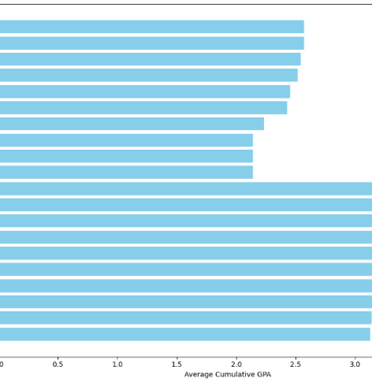
Subject-wise GPA Performance: Subjects like HONR, THEA, and POLS continue to lead with the highest average cumulative GPAs, indicating strong academic outcomes. Conversely, WRIT, READ, and EMGT are positioned at the bottom with significantly lower average GPAs, signaling potential academic hurdles. This contrast suggests variations in subject difficulty, instructional quality, or student preparedness. Interventions such as course redesign or targeted academic support may help uplift performance in underperforming areas. Focusing resources on low-performing subjects can promote GPA consistency across departments.

Slide 21
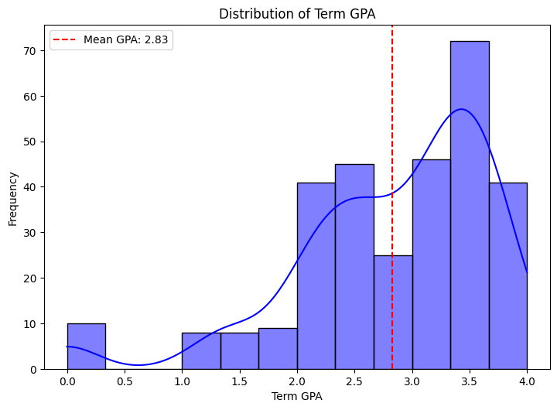
Overall Student Academic Performance Dashboard:
The average Term GPA is 2.83, with most students achieving between 3.0 and 3.7.
The distribution curve skews slightly right, reflecting better-than-average academic results.
A significant portion of students perform above the mean, indicating academic success.
However, a small percentage fall below the average, suggesting a need for targeted support.
Mentoring programs should focus on uplifting below-average performers to close achievement gaps.

Slide 22
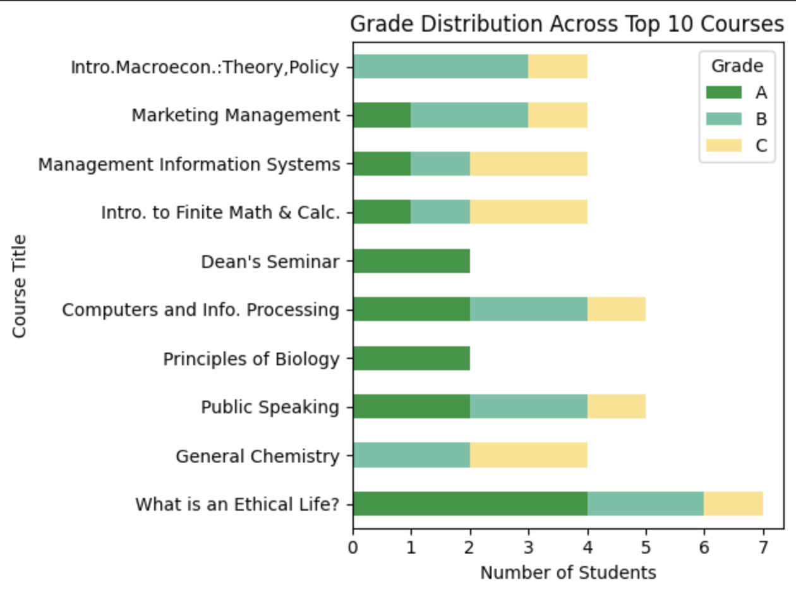
Grade Distribution Across All Courses:
A wide range of grades (A to F) appears across the top 10 courses.
Courses like “What is an Ethical Life?” and “General Chemistry” show both strong and weak performance.
This disparity hints at inconsistent grading practices or course difficulty levels.
Students may benefit from more standardized evaluation methods.
Enhanced academic support is recommended for courses with frequent low scores.

Slide 23
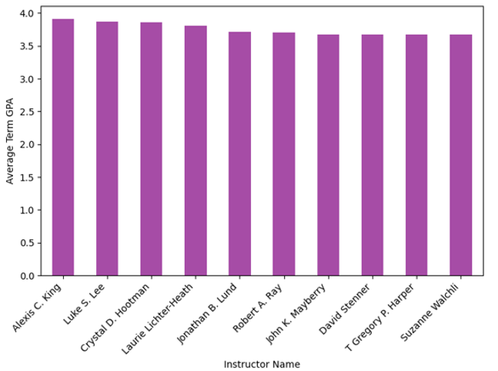
Top Instructor Impact on Term GPA:
All instructors displayed in the chart have average term GPAs exceeding 3.7.
This suggests consistent instructional quality and effective student engagement.
High instructor GPAs correlate with strong teaching practices.
Institutions can learn from these top performers to improve teaching outcomes.
Peer mentoring programs could help raise standards across other instructors.

Slide 24
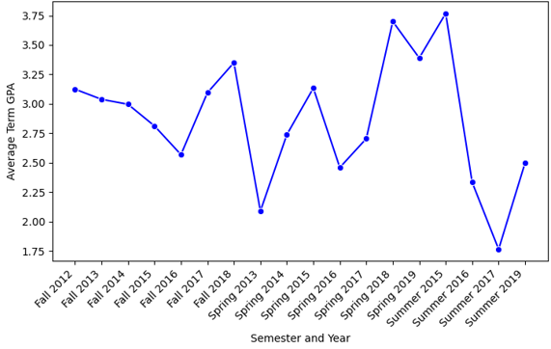
Performance Comparison Between Years/Terms:
GPA trends were stable from 2012 to 2018 before sharply declining in later summer terms.
The drop aligns with increased academic pressure and likely pandemic disruptions.
Summer sessions appear more vulnerable to reduced performance.
Curriculum delivery methods may need adjustments for short or compressed terms.
Reinforcement strategies and summer-specific academic support can mitigate these effects.

Slide 25
Stakeholder-Specific Metrics
Administrators → Graduation rate, GPA trends, retention analysis
Faculty → Instructor impact on GPA, course-level performance, peer comparisons
Academic Advisors → Credit hour vs GPA patterns, student progression, dropout alerts
Curriculum Committees → Grade distribution across courses, high-failure courses (e.g., ACTY)
Students → Term-wise GPA trends, elective popularity, pass/fail trends
Data Analysts → Dashboard KPIs, data standardization, performance forecasting

Slide 26
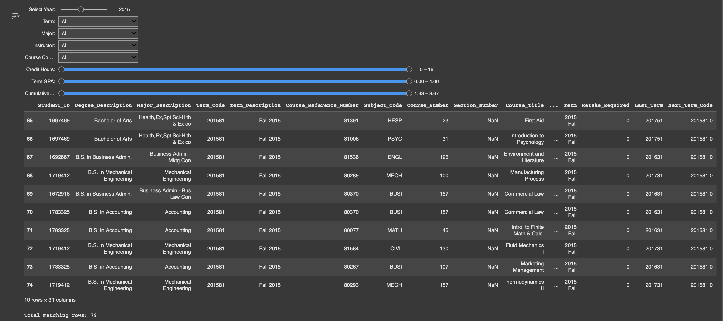
Filter:

Slide 27
Key Recommendations
Provide personalized support to low-GPA students
Launch peer reviews and faculty mentorship programs
Redesign high-failure courses (e.g., ACTY) with new content and methods
Introduce GPA-based early alert systems
Standardize summer terms and grading policies
Deploy live dashboards for GPA, dropout, and retake monitoring

Slide 28
Conclusion:
This project used Python and data science techniques to analyze student performance trends. It identified key GPA patterns, instructional influence, and departmental disparities. Recommendations aim to boost student success, enhance teaching quality, and guide academic strategy.

Slide 29

Acknowledgments
We thank Prof. Arshad Khan for his guidance, Dr. James Hetrick for leading the Data Science program. We’re also grateful to our peers and families for their support throughout this project.

Slide 30
Thank You
Questions?

